Slide 1
E-commerce Data Visualization Project
E-commerce Platform Annual Report 2025

Slide 2
Business objective
The goal is to use data insights to analyze sales, customer behavior, and revenue trends
A KPI Dashboard will track sales performance, top products, regions, and sales channels.
This will help improve marketing strategies, customer experience, and business growth.
The insights will drive smart decision-making to stay competitive in e-commerce

Slide 3
Project scope
Compare the sales and orders using single chart.
Which month got the highest sales and orders?
Who purchased more - men or women in 2022?
What are different order status in 2022?
List top 10 states contributing to the sales?
Relation between age and gender based on number of orders
Which channel is contributing to maximum sales?
Highest selling category?

Slide 4
Solution approach
The dataset includes multiple sheets covering sales, orders, customer demographics, and regions.
Excel was used for data cleaning, analysis, and visualization with Pivot Tables and Charts.
Data was imported, processed, and transformed to ensure accuracy and consistency.
Pivot Tables summarized key metrics, forming the foundation of the interactive dashboard.

Slide 5
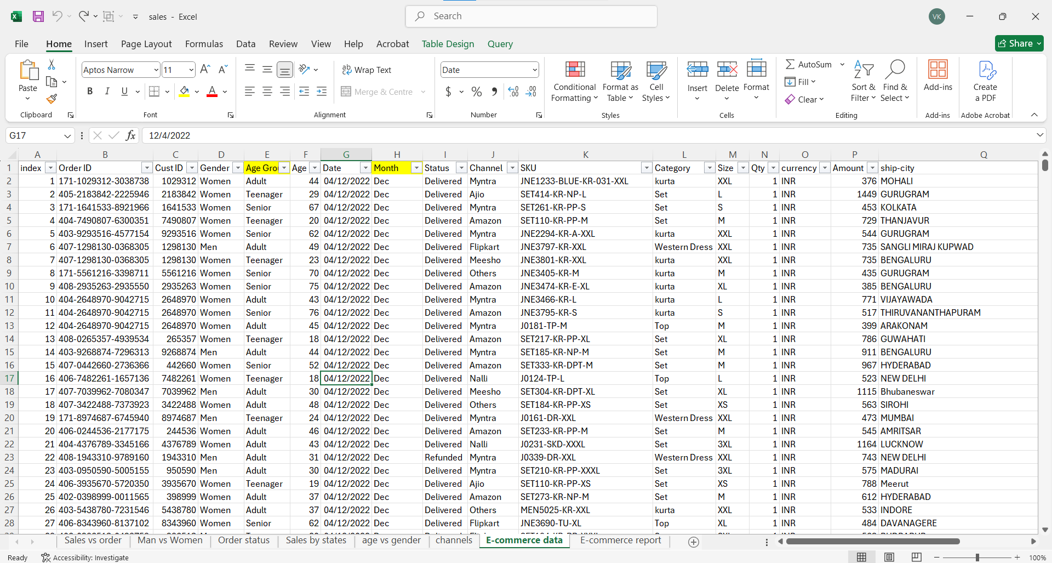
Data cleaning and transformation in Excel

Slide 6
Solution approach
The data underwent thorough cleaning to ensure accuracy before proceeding with analysis.
Additional columns, Age Group and Month, were introduced to enhance data segmentation.
The Age Group classification provides insights into the shopping behavior of different demographics.
Monthly sales trends were analyzed to identify peak performance periods and strategic opportunities.

Slide 7
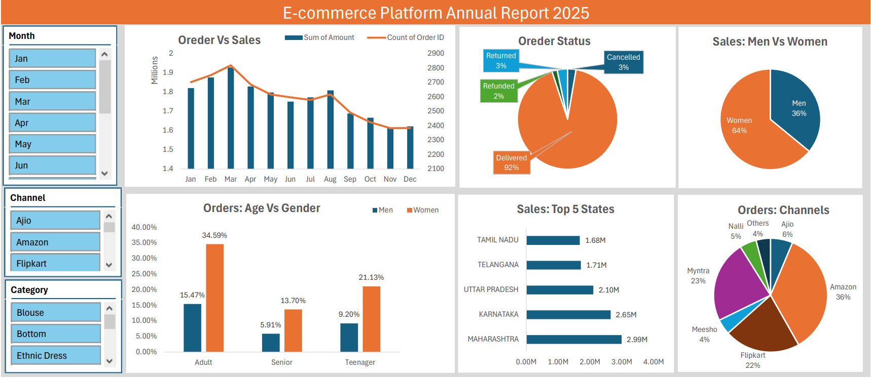
E-commerce Platform Dashboard

Slide 8
Sample Insights
Women are more likely to buy compared to men (~65%).
Maharashtra, Karnataka, and Uttar Pradesh are the top 3 states (~35%).
Adult age group (30-49 yrs) is max contributing (~50%).
Amazon, Flipkart, and Myntra channels are max contributing (~80%).

Slide 9
Final Conclusion to improve E-commerce Platform sales
Target women customers of age group (30-49 yrs) living in Maharashtra, Karnataka, and Uttar Pradesh by showing ads/offers/coupons available on Amazon, Flipkart, and Myntra.
Ensure top-selling products for 30-49 age group are available in Maharashtra, Karnataka, and Uttar Pradesh for higher sales.
Offer special deals & promotions during peak seasons on Amazon, Flipkart, and Myntra to drive more purchases.

Slide 10
Thank you!

